Slide 1

Improving Integration between Bahmni ERM and Odoo
By: Moeketsi Ntaole 201902695
Lehlohonolo Moeling 201902032
Supervisor: Mr. Lebajoale Mphatsi

Slide 2
Table of contents
01
04
02
05
03
06
overview
Scope
background
Solutions
Objectives
Methodologies

Slide 3
Table of contents
07 Time frame 08 Conclusion

Slide 4

01
Overview

Slide 5

02 Background
Integrating Bahmni ERM and Odoo**The project addresses challenges in the current integration between Bahmni ERM and Odoo, aiming to replace the atom feed-based system with a more robust Messaging-Oriented Middleware (MOM) solution. The focus is on achieving real-time synchronization for seamless data exchange between healthcare operations (Bahmni ERM) and business processes (Odoo). The project responds to the need for an efficient, secure, and responsive integration, enhancing overall organizational workflows and patient care.

Slide 6
Objectives 04
The goal
Our aim
Goals inside a company are usually specific and measurable, with clearly defined deadlines and outcomes. The company’s goals help focus the actions of the organization and ensure resources are used effectively
An aim in a corporate context is a goal or desired result that the organization seeks to achieve. The aim should be clear and achievable, and often serves as the basis for further planning actions inside the organization

Slide 7
Objectives
Assesment
MOM Selection
Create Data consumer modules
Conduct thorough assessment of current Atom-Feed-based CDC integration to identify strengths, weaknesses and areas of improvement
Select appropriate MOM considering performance, reliability , and compatibility with Bahmni ERM and Odoo
Create a data consumer module in Odoo that will consume data events and implement data transformation logic
MOM integration
Create data producer modules
Data migration strategy
Develop a data producer within Bahmni ERM to capture data events and publish them to MOM
Implement selected MOM based solution ensuring realtime syncronization, error handling and data security.
Create detailed strategy to outline the process of transitioning from Atom fee to chosen MOM solution

Slide 8

05
Problem And Scope

Slide 9




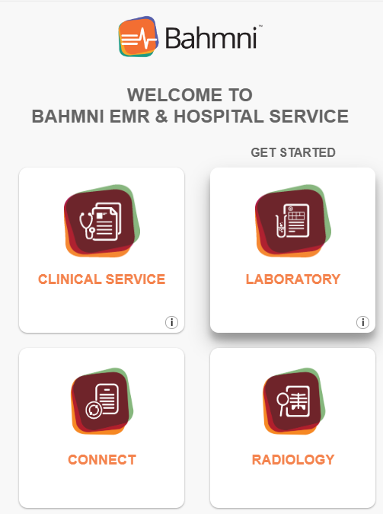
Scope Statement
Scope statement
The project aims to enhance the existing CDC (Change Data Capture) integration within the Bahmni ERM (Electronic Medical Record) and Odoo systems by transitioning from the current Atom-feed-based mechanism to a more robust Messaging-Oriented Middleware (MOM) solution. The objective is to improve real-time data synchronization, error handling, and security measures.

Slide 10
06
Deliverables and time frame

Slide 11
Project Deliverables: Enhancing Bahmni ERM and Odoo Integration
2. Data Producer Module (Bahmni ERM):
Creation of a data producer module within Bahmni ERM,
capturing patient health records, appointments, and relevant data changes,
and publishing these as data
events to the MOM platform.
3. Data Consumer Module (Odoo):
Development of a data consumer module within Odoo,
subscribing to MOM topics and consuming data events.
This module includes logic for data mapping and
transformation to update corresponding records in Odoo.
Messaging-Oriented Middleware (MOM):
Development and implementation of a MOM solution to serve as the central hub for seamless data exchange
between Bahmni ERM and Odoo.

Slide 12
4.Real-Time Data Synchronization:
Implementation of mechanisms ensuring that data changes in Bahmni ERM are efficiently synchronized with Odoo in near real-time, overcoming challenges of the previous atom feed-based approach.
5. Error Handling and Retry Mechanism
Integration of robust error handling mechanisms to address any data synchronization failures gracefully, minimizing disruptions and ensuring data integrity.
6. Data Security Measures
Application of appropriate security measures within the middleware to protect patient health records and financial data during data exchange. This includes encryption and access controls. These deliverables collectively aim to create a more efficient, reliable, and secure integration between Bahmni ERM and Odoo, enhancing organizational workflows and improving patient care through streamlined data exchange.

Slide 13
Project roadmap
Initiative | Objective | Jan | Feb | Mar | Apr | May | Jun | Jul | Aug | Sep | Oct | Nov | Dec
Market research | Increase brand awareness by 30% within the first year
Product development | Achieve a customer satisfaction rate of 90%
Marketing campaign | Increase revenue by 20% within the first year
Product launch | Achieve a customer satisfaction rate of 90% within the first year
Expansion | Reduce costs by 15% within the first year by expanding the product
Partnership | Reach profitability within 18 months of launch

Slide 14
01
methodology

Slide 15
Resources
Human
resources
Financial resources
Physical resources
The project team is responsible for the successful execution of the project. Our team is composed of two partners with the necessary skills and expertise to complete the project on time and
within budget.
Our project budget is M2000. This budget includes all expenses associated with the project. This bugdget is from NMDS.
Our project requires a number of specialized pieces of equipment. We will be using our laptops and the B.Eng lab.

Slide 16

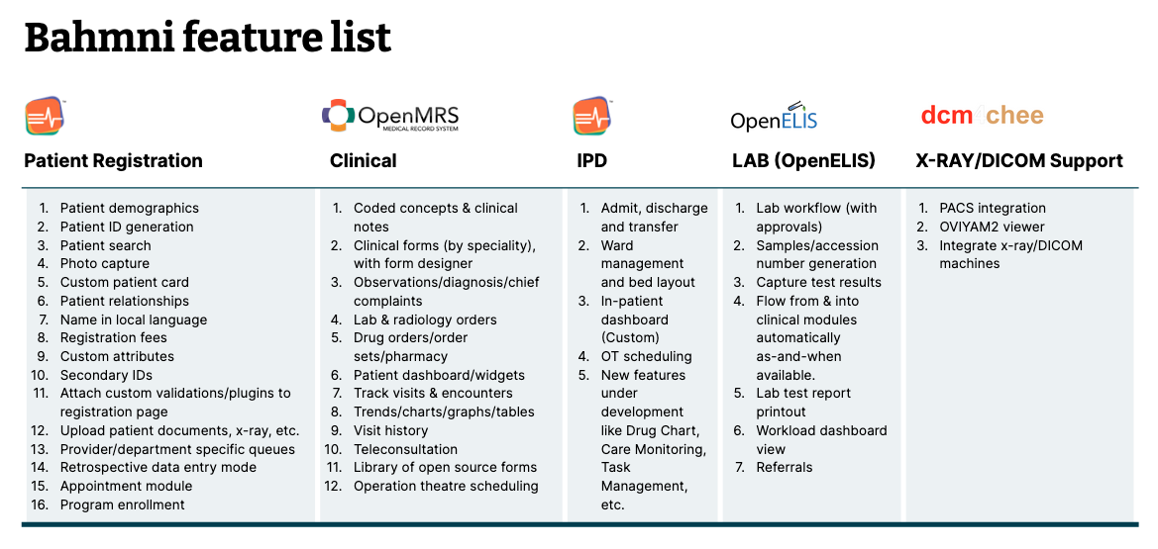
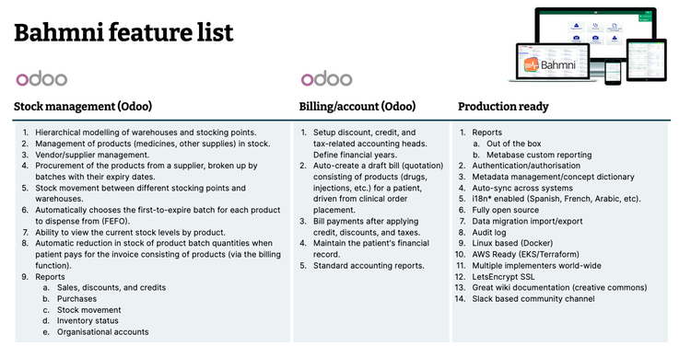
Open source HIS
Components
Brahmin is an open source and free to use Hospital Information system (HIS)
One of the 23 digital public goods recognized projects
Implemented in more than 500 hospital across 50 courtiers
Lesotho implementation in work
Bahmni combines three open source products
OpenMRS Distribution: For electronic medical recording
OpenERP: For Hospital Operations
OpenELIS: Lab information management system
Feature List

Slide 17
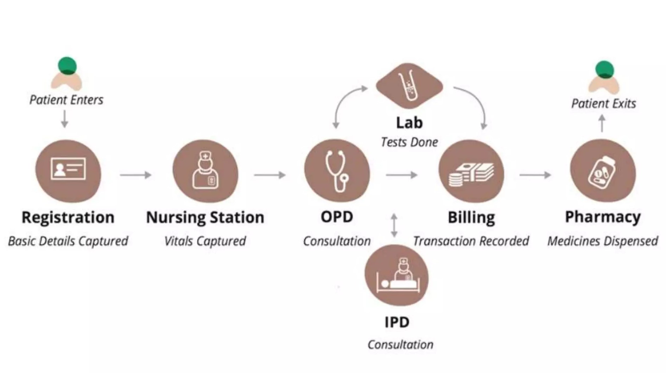
Bahmni – Focuses on all aspects of patient care

Slide 18
Odooo
Sources of funding
Personnel costs
Funding for a company can come from personal savings or investments, bank loans and other loan options, venture capital and angel investors, grants, competitions or programs, crowdfunding…
Personnel costs refer to the expenses incurred in hiring, training and retaining staff for a company. This can include salaries, bonuses, benefits and other payroll-related costs
Equipment and materials
Travel and miscellaneous
Equipment and materials costs refer to all the expenses related to the purchasing, maintenance and upkeep of any physical items used in production or other business processes inside the company
Travel and miscellaneous costs refer to expenses related to any travel-related activities, such as conferences, trainings or business trips. It may also include office supplies, communications services, licenses and other miscellaneous expenses

Slide 19
Integration and Interoperability
How does Bahmni provide integration over all services?
Bahmni is modular
New components in and old ones removed
Bahmni can be enhanced at multiple levels
Custom distribution of OpenMRS
Adding new definitions for different services
Adding new components based on standards
Atom Feeds over HTTP
All Bahmni components communicate with each other using Atom feeds
Each component publishes a log of relevant events happening
Other components listen to this feed using libraries
Only authorized clients can listen to feeds
Rich data interface over standard API and push and pull data updates directly

Slide 20
Requirements
Functional Requirements
Non-Fuctional Requirements
Data producer on Bahmni
Data consumer on Odoo
Real-time Syncroniza3ion
Error handling and fault tolerance
MOM system
Reliability
Scalability
fault tolerant
Compatibility
resource efficiency
throughput

Slide 21
01
solutions

Slide 22
Project activities
Activity | Start date | End date | Resource | Cost | Revenue
Market research | 1/1/20XX | 1/15/20XX | Market research firm | $20,000
Product development | 1/16/20XX | 6/30/20XX | R&D team | $200,000
Beta testing | 7/1/20XX | 8/15/20XX | Beta testers | $10,000
Marketing campaign | 1/1/20XX | 1/15/20XX | Advertising agency | $100,000
Product launch | 1/16/20XX | 6/30/20XX | Sales team | $50,000 | $500,000
Post-launch support | 7/1/20XX | 8/15/20XX | Support team | $50,000 | $800,000

Slide 23
Project timeline
Conduct market research and analyze the target audience to identify opportunities
Create the product or service by defining features, design, and functionality
Test the product with a group of users to receive feedback and improve the product
Execute a marketing campaign to promote the product to the target audience
Release the product or service to the market with a comprehensive launch plan
Provide customer support to ensure customer satisfaction
Explore opportunities for growth and expansion of the product or service
Continuously improve the product based on customer feedback and market trends

Slide 24
10 million
First-year revenue of the project

Slide 25
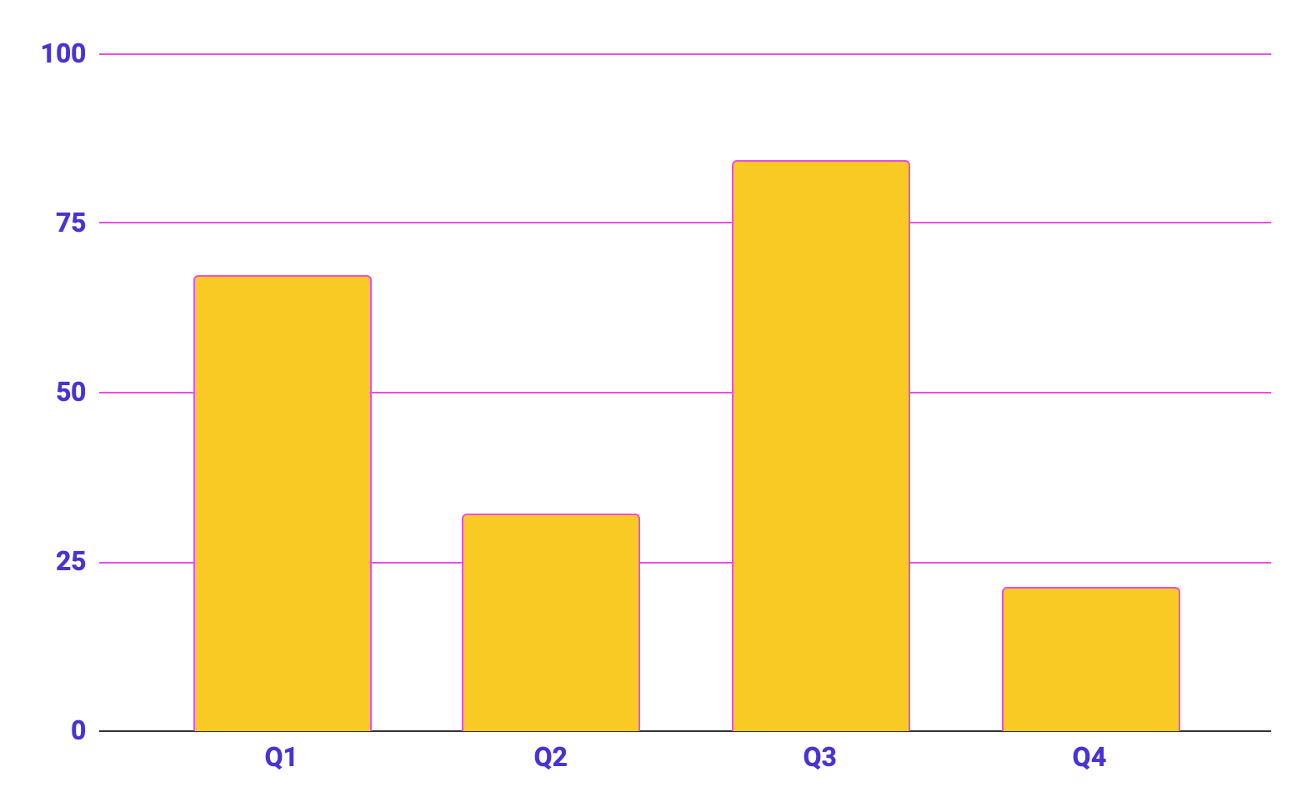
Project data
Benefits of using graphs
Graphs in project proposals offer visual organization, enabling clear presentation of information in a structured format. They enhance the visual appeal, facilitate data comparison and improve overall clarity and professionalism of your project proposal
Follow the link in the graph to modify its data and then paste the new one here. For more info, click here

Slide 26




conclusion
A photo showcase can be a useful addition to a business project proposal as it can help to visually communicate the concept or idea being proposed

Slide 27
Thanks!
Do you have any questions?
moeketsintaole@gmail.com
57742381
Partners contact infor
Please keep this slide for attribution

Slide 28
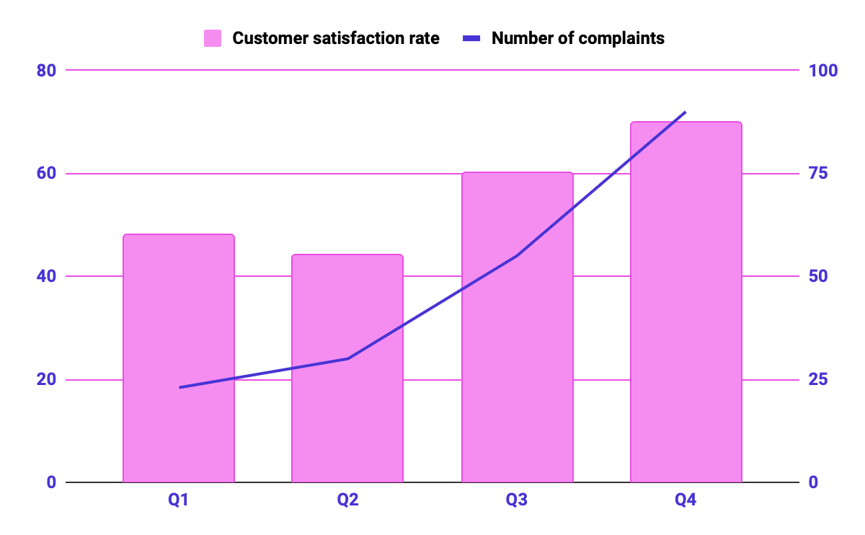
KPI dashboard
120 u/day
2h
Resource | Utilization rate | Cost per unit
Labor | 85% | $50
Equipment | 70% | $100
Materials | 95% | $20
Rent | 90% | $1,000
Energy | 80% | $80
Software licenses | 80% | $200
Advertising | 60% | $500
Output per worker
Time to complete a task
Follow the link in the graph to modify its data and then paste the new one here. For more info, click here

Slide 29
Icon pack

Slide 30
Alternative resources
Here’s an assortment of alternative resources whose style fits the one of this template:
Vectors
Health and fitness instagram stories collection with photo
Instagram sale stories collection with photo

Slide 31

How to create a project proposal
Creating a project proposal can be done in five steps:
Define the project objectives and timeline
Identify resources needed to complete the project
Develop a budget for the project and estimate any potential risks associated with it
Write down your proposed solution and provide supporting documents or evidence that prove its feasibility if necessary
Develop a communication plan to ensure key stakeholders are kept informed of progress throughout the entire process

Slide 32
Contents of this template
You can delete this slide when you’re done editing the presentation
Fonts | To view this template correctly in PowerPoint, download and install the fonts we used
Used and alternative resources | An assortment of graphic resources that are suitable for use in this presentation
Thanks slide | You must keep it so that proper credits for our design are given
Colors | All the colors used in this presentation
Icons and infographic resources | These can be used in the template, and their size and color can be edited
Editable presentation theme | You can edit the master slides easily. For more info, click here
For more info: Slidesgo | Blog | FAQs
You can visit our sister projects: Freepik | Flaticon | Storyset | Wepik | Videvo

Slide 33
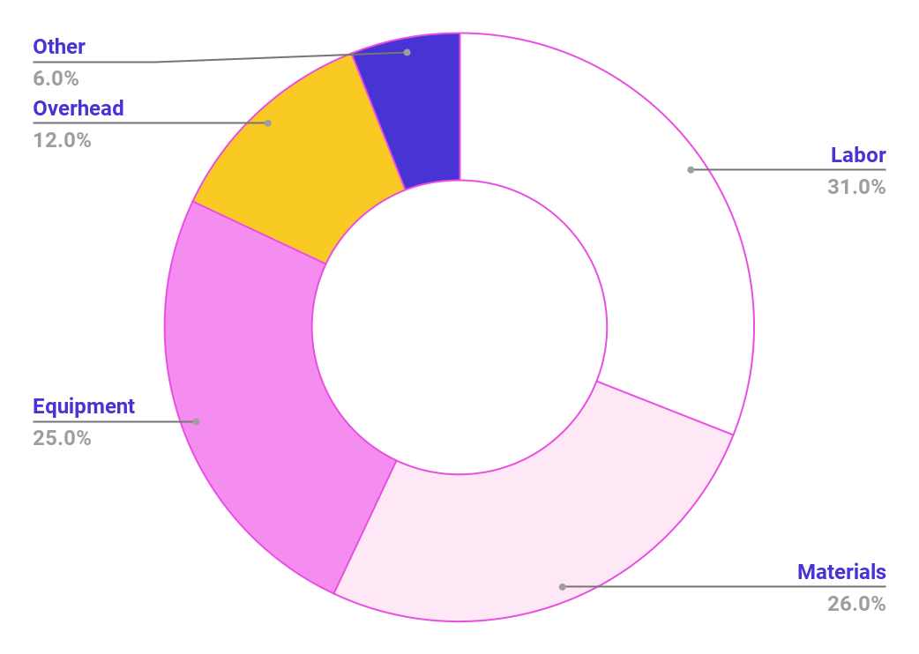
Project expenses
Labor
Materials
Equipment
Overhead
Other
Follow the link in the graph to modify its data and then paste the new one here. For more info, click here

Slide 35

200 units
25%
Rememeber to insert medical things on the background
Net profit of the project
Break-even point
Market share in the industry

